Slide 1

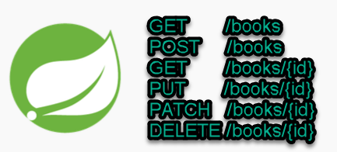
Spring boot REST Example [book] + JPA
Postman client
SpringBootDemo
DB
Consuming a RESTful Web Services by using Postman client
REST Endpoints to Create/Update/
Get/Delete book details

Slide 2

Spring boot REST Example [book] + JPA
Spring Boot provides spring-boot-starter-data-jpa starter to connect Spring application with relational database efficiently.
Spring Data JPA provides complete abstraction over the DAO layer. We don’t need to write the implementation for the DAO layer anymore; Spring Data JPA auto-generates the implementation for the DAO layer.

Slide 3
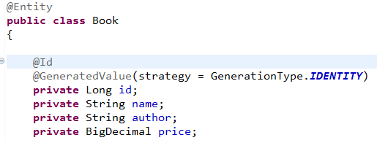
Spring boot REST Example [book] + JPA
JPA Entity is any Java POJO, which can represent the underlying table structure. As our service is based on the Book table, we created a Book Entity object.
The POJO is annotated with @Entity, which is to denote this is an entity object for the table name Book.
id is our Primary Key and, hence, marked as @Id. The field id is also marked with @GeneratedValue, which denotes that this is an Auto-Increment column and Hibernate will take care of putting in the next value. Hibernate will first query the underlying table to know the max value of the column and increment it with next insert. This also means that we don’t need to specify any value for the Id column and can leave it blank.

Slide 4
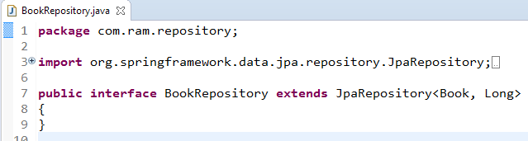
Spring boot REST Example [book] + JPA
The Repository represents the DAO layer, which typically does all the database operations. Thanks to Spring Data, who provides the implementations for these methods.
There are no method declarations here in the BookRepository. That is because Spring Data’s CrudRepository Interface has already declared basic CRUD methods.

